Slide 1
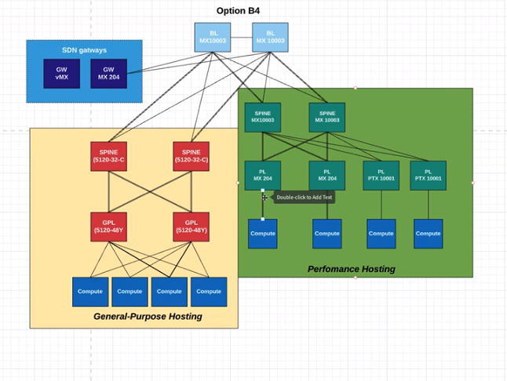
3
Fabric 1
FUTURE
Fabric 2

